Slide 1
sMGM: parameterizable AEAD-mode
Bozhko A., Akhmetzyanova L., Alekseev E., Babueva A., Smyshlyaev S.
CryptoPro LLC
CTCrypt’2022

Slide 2
Previously on CTCrypt

Slide 3
nonce-based AEAD
(Authenticated Encryption with Associated Data)
$Enc\left(K, N,A,P\right)→\left(C,T\right)$: deterministic encryption algorithm
$Dec\left(K,N,A,C,T\right)→P or⊥$: deterministic decryption algorithm
$K$ – key
$N$ – nonce (used only once under single key)
$A$ – associated data (should be authenticated, but not encrypted)
$P$ – plaintext (should be authenticated and encrypted)
$C$ – ciphertext
$T$ – authentication tag

Slide 4
MGM and MGM2
2017 – MGM mode – V. Nozdrunov «Parallel and double block cipher mode of operation (PD-mode) for authenticated encryption», CTCrypt’17.
2021 – MGM2 – Liliya Akhmetzyanova, Evgeny Alekseev, Alexandra Babueva, Andrey Bozhko, Stanislav Smyshlyaev «Misuse-resistant MGM2 mode», CTCrypt’21
Provably secure in standard models
Replaces CNT by CTR with fixed bits
Uses multilinear function as a core
Provably secure in models with nonce misuse

Slide 5
In this episode of CTCrypt
We did it with sMGM!

Slide 6
Misuse-resistant confidentiality
weak notion
strong notion
ciphertext of each query $(N,A,P)$ with unique $N$is indistinguishable from a «garbage»
ciphertext of each unique query $(N,A,P)$ is indistinguishable from a «garbage»
«ideal» confidentiality is achieved only for messages that were encrypted correctly
confidentiality «modulo repetition»
is achieved for all messages

Slide 7
In this episode of CTCrypt
And that too!
(somewhat)

Slide 8
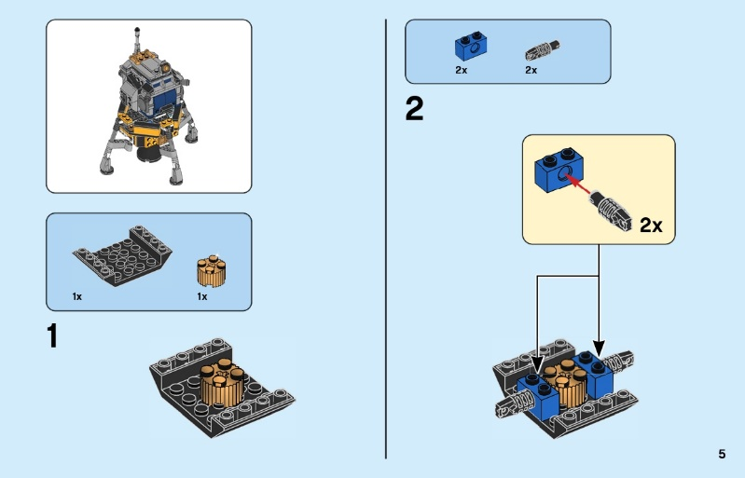
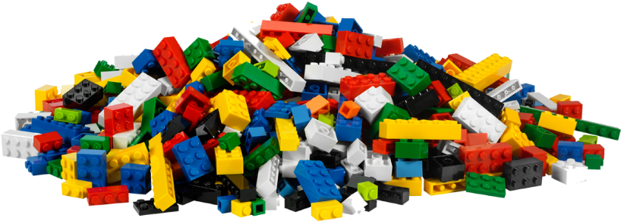
vs
Parametrization
Framework

Slide 9
vs
Parametrization
Framework

Slide 10
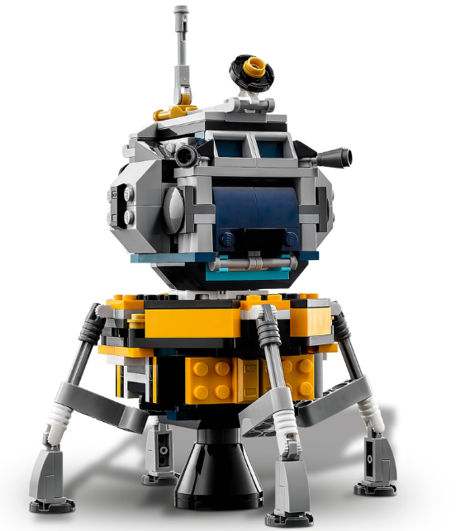
vs
Parametrization
Framework

Slide 11
vs
Parametrization
Framework
Give me scheme with four legs!

Slide 12
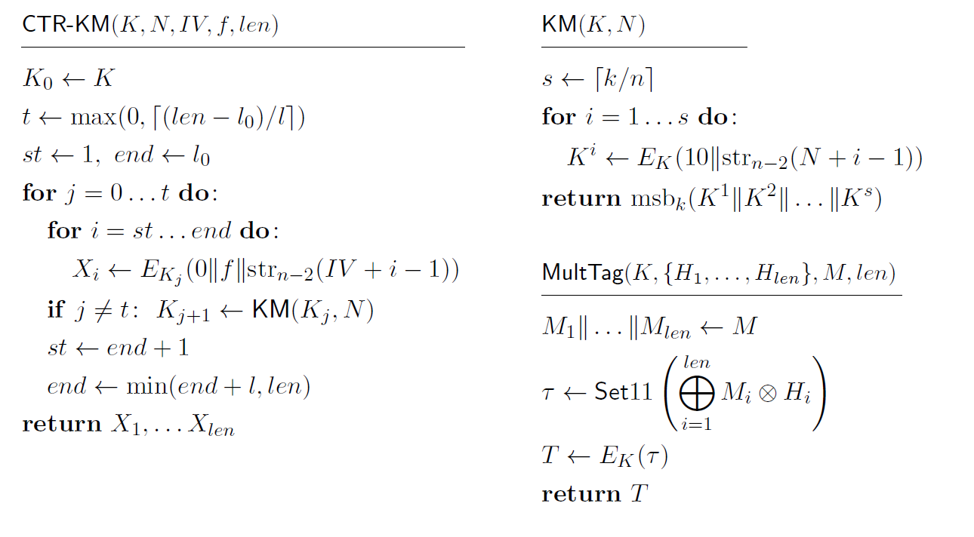
sMGM (strong MGM) – parametrizable AEAD
$$sMGM$$
$E$,
$r$,
$l_{0}$,
$l$,
$$siv$$
Parameters

Slide 13
sMGM (strong MGM) – parametrizable AEAD
$$sMGM$$
$E$,
$r$,
$l_{0}$,
$l$,
$$siv$$
Parameters
CTR-like gamma generation function with optional re-keying

Slide 14
sMGM (strong MGM) – parametrizable AEAD
$$sMGM$$
$E$,
$r$,
$l_{0}$,
$l$,
$$siv$$
Parameters
CTR-like gamma generation function with optional re-keying
Multilinear Galois tag function

Slide 15
sMGM (strong MGM) – parametrizable AEAD
$$sMGM$$
$E$,
$r$,
$l_{0}$,
$l$,
$$siv$$
a block cipher
a nonce length

Slide 16
sMGM (strong MGM) – parametrizable AEAD
$$sMGM$$
$E$,
$r$,
$l_{0}$,
$l$,
$$siv$$
$siv$ flag is responsible for applying SIV (synthetic IV, BRS2002) construction to provide nonce misuse resistance
$$P$$
$$A$$
$$N$$
CTR-KM
CTR-KM +
MultTag
$$C$$
$$T$$
$$siv=0$$

Slide 17
sMGM (strong MGM) – parametrizable AEAD
$$sMGM$$
$E$,
$r$,
$l_{0}$,
$l$,
$$siv$$
$siv$ flag is responsible for applying SIV (synthetic IV, BRS2002) construction to provide nonce misuse resistance
$$P$$
Encryption
$$A$$
$$N$$
CTR-KM
CTR-KM +
MultTag
$$C$$
$$T$$
$$siv=0$$

Slide 18
sMGM (strong MGM) – parametrizable AEAD
$$sMGM$$
$E$,
$r$,
$l_{0}$,
$l$,
$$siv$$
$siv$ flag is responsible for applying SIV (synthetic IV, BRS2002) construction to provide nonce misuse resistance
$$P$$
Tag generation
$$A$$
$$N$$
CTR-KM
CTR-KM +
MultTag
$$C$$
$$T$$
$$siv=0$$

Slide 19
sMGM (strong MGM) – parametrizable AEAD
$$sMGM$$
$E$,
$r$,
$l_{0}$,
$l$,
$$siv$$
$siv$ flag is responsible for applying SIV (synthetic IV, BRS2002) construction to provide nonce misuse resistance
$$P$$
$$A$$
$$N$$
CTR-KM +
MultTag
$$A$$
$$N$$
CTR-KM
$$P$$
CTR-KM +
MultTag
$$C$$
$$T$$
CTR-KM
$$T$$
$$C$$
$$siv=0$$
$$siv=1$$

Slide 20
sMGM (strong MGM) – parametrizable AEAD
$$sMGM$$
$E$,
$r$,
$l_{0}$,
$l$,
$$siv$$
$siv$ flag is responsible for applying SIV (synthetic IV, BRS2002) construction to provide nonce misuse resistance
$$P$$
$$A$$
$$N$$
CTR-KM +
MultTag
$$A$$
$$N$$
CTR-KM
$$P$$
CTR-KM +
MultTag
$$C$$
$$T$$
CTR-KM
$$T$$
$$C$$
$$siv=0$$
$$siv=1$$

Slide 21
sMGM (strong MGM) – parametrizable AEAD
$$sMGM$$
$E$,
$r$,
$l_{0}$,
$l$,
$$siv$$
$siv$ flag is responsible for applying SIV (synthetic IV, BRS2002) construction to provide nonce misuse resistance
$$P$$
$$A$$
$$N$$
CTR-KM +
MultTag
$$A$$
$$N$$
CTR-KM
$$P$$
CTR-KM +
MultTag
$$C$$
$$T$$
CTR-KM
$$IV=T$$
$$T$$
$$C$$
$$siv=0$$
$$siv=1$$

Slide 22
sMGM (strong MGM) – parametrizable AEAD
$$sMGM$$
$E$,
$r$,
$l_{0}$,
$l$,
$$siv$$
$siv$ flag is responsible for applying SIV (synthetic IV, BRS2002) construction to provide nonce misuse resistance
$$P$$
$$A$$
$$N$$
CTR-KM +
MultTag
$$A$$
$$N$$
CTR-KM
$$P$$
CTR-KM +
MultTag
$$C$$
$$T$$
CTR-KM
$$T$$
$$C$$
$$siv=0$$
$$siv=1$$

Slide 23
sMGM (strong MGM) – parametrizable AEAD
$$sMGM$$
$E$,
$r$,
$l_{0}$,
$l$,
$$siv$$
re-keying parameters
$l_{0}$ and $l$ parametrize the sizes of the initial and subsequent sections respectfully in the re-keying. Re-keying is incorporated within CTR-KM function for both tag generation and encryption

Slide 24
sMGM (strong MGM) – parametrizable AEAD
$$sMGM$$
$E$,
$r$,
$l_{0}$,
$l$,
$$siv$$
$$l_{0}$$
$$IV+0$$
$$IV+1$$
$$IV+l_{0}−1$$
$$E_{K}$$
$$E_{K}$$
$$E_{K}$$
$$X_{1}$$
$$X_{2}$$
$$X_{l_{0}}$$
$$K$$

Slide 25
sMGM (strong MGM) – parametrizable AEAD
$$sMGM$$
$E$,
$r$,
$l_{0}$,
$l$,
$$siv$$
$$l_{0}$$
$$IV+0$$
$$IV+1$$
$$IV+l_{0}−1$$
$$E_{K}$$
$$E_{K}$$
$$E_{K}$$
$$X_{1}$$
$$X_{2}$$
$$X_{l_{0}}$$
$$K$$
$$KM$$
$$K_{1}$$
$$N$$

Slide 26
sMGM (strong MGM) – parametrizable AEAD
$$sMGM$$
$E$,
$r$,
$l_{0}$,
$l$,
$$siv$$
$$l_{0}$$
$$l$$
$$IV+0$$
$$IV+1$$
$$IV+l_{0}−1$$
$$IV+l_{0}$$
$$IV+l_{0}+l−1$$
$$E_{K}$$
$$E_{K}$$
$$E_{K}$$
$$E_{K_{1}}$$
$$E_{K_{1}}$$
$$X_{1}$$
$$X_{2}$$
$$X_{l_{0}}$$
$$X_{l_{0}+1}$$
$$X_{l_{0}+l}$$
$$K_{0}$$
$$KM$$
$$K$$
$$K_{1}$$
$$N$$

Slide 27
sMGM (strong MGM) – parametrizable AEAD
$$sMGM$$
$E$,
$r$,
$l_{0}$,
$l$,
$$siv$$
$$l_{0}$$
$$l$$
$$l$$
$$IV+0$$
$$IV+1$$
$$IV+l_{0}−1$$
$$IV+l_{0}$$
$$IV+l_{0}+l−1$$
$$IV+l_{0}+l$$
$$IV+l_{0}+2l−1$$
$$E_{K}$$
$$E_{K}$$
$$E_{K}$$
$$E_{K_{1}}$$
$$E_{K_{1}}$$
$$E_{K_{1}}$$
$$E_{K_{1}}$$
$$X_{1}$$
$$X_{2}$$
$$X_{l_{0}}$$
$$X_{l_{0}+1}$$
$$X_{l_{0}+l}$$
$$X_{l_{0}+l+1}$$
$$X_{l_{0}+2l}$$
$$K$$
$$KM$$
$$K_{1}$$
$$KM$$
$$K_{2}$$
$$KM$$
$$N$$
$$N$$
$$N$$

Slide 28
sMGM (strong MGM) – parametrizable AEAD
$$sMGM$$
$E$,
$r$,
$l_{0}$,
$l$,
$$siv$$
It is easy to see, that one can turn off re-keying by setting $l_{0}$ to the maximum possible total length of plaintexts and associated data.
Moreover, by setting $l_{0}$ to zero the main key will be used only to generate the first key of the re-keying chain.

Slide 29
sMGM (strong MGM) – parametrizable AEAD
$$sMGM$$
$E$,
$r$,
$l_{0}$,
$l$,
$$siv$$
$$l_{0}$$
Nonce is always used as a base value for the re-keying. Hence, new key chain for every fresh nonce value
Major difference from classic internal re-keying:
$$l$$
$$l$$
$$IV+0$$
$$IV+1$$
$$IV+l_{0}−1$$
$$IV+l_{0}$$
$$IV+l_{0}+l−1$$
$$IV+l_{0}+l$$
$$IV+l_{0}+2l−1$$
$$E_{K_{0}}$$
$$E_{K_{0}}$$
$$E_{K_{0}}$$
$$E_{K_{1}}$$
$$E_{K_{1}}$$
$$E_{K_{1}}$$
$$E_{K_{1}}$$
$$X_{1}$$
$$X_{2}$$
$$X_{l_{0}}$$
$$X_{l_{0}+1}$$
$$X_{l_{0}+l}$$
$$X_{l_{0}+l+1}$$
$$X_{l_{0}+2l}$$
$$K$$
$$KM$$
$$K_{1}$$
$$KM$$
$$K_{2}$$
$$KM$$
$$N$$
$$N$$
$$N$$

Slide 30
sMGM (strong MGM) – parametrizable AEAD
$$sMGM$$
$E$,
$r$,
$l_{0}$,
$l$,
$$siv$$
$$N_{1}||0$$
$$K_{I1}^{1}$$
$$K_{I2}^{1}$$
$$K_{I3}^{1}$$
$$K_{I4}^{1}$$
$$K_{I5}^{1}$$
Integrity keys
$N_{1}$:
$$K$$
$$N_{1}||s$$
$$K_{E1}^{1}$$
$$K_{E2}^{1}$$
$$K_{E3}^{1}$$
$$K_{E4}^{1}$$
$$K_{E5}^{1}$$
$$N_{2}||0$$
$$K_{I1}^{2}$$
$$K_{I2}^{2}$$
$$K_{I3}^{2}$$
$$K_{I4}^{2}$$
$$K_{I5}^{2}$$
Encryption keys
$N_{2}$:
$$K$$
$$N_{2}||s$$
$$K_{E1}^{2}$$
$$K_{E2}^{2}$$
$$K_{E3}^{2}$$
$$K_{E4}^{2}$$
$$K_{E5}^{2}$$
$$N_{3}||0$$
$$K_{I1}^{3}$$
$$K_{I2}^{3}$$
$$K_{I3}^{3}$$
$$K_{I4}^{3}$$
$$K_{I5}^{3}$$
$N_{3}$:
$$K$$
$$N_{3}||s$$
$$K_{E1}^{3}$$
$$K_{E2}^{3}$$
$$K_{E3}^{3}$$
$$K_{E4}^{3}$$
$$K_{E5}^{3}$$

Slide 31
Security of sMGM
We provide security bounds for misuse resistant sMGM instance (i.e. $sMGM[E, r, l_{0}, l, 1]$) regarding:
strong misuse-resistant integrity ($MRAE−int$)
strong misuse-resistant integrity and confidentiality ($MRAE$)
Formal description for these security notions can be found in the paper.
31

Slide 32
Security of sMGM
We will use the following notations:
$$m_{A}$$ | maximum block-length of associated data in each query
$$m_{P}$$ | maximum block-length of plaintexts and ciphertexts in each query
$$q_{E}$$ | number of queries to the Encrypt oracle | $$q=q_{E}+q_{D}$$
$$q_{D}$$ | number of queries to the Decrypt oracle
$$q_{N}$$ | number of distinct nonce values in all queries
$$q_{R}$$ | number of queries with the same nonce
32

Slide 33
Misuse-resistant integrity of sMGM
Theorem 1 (integrity). For any adversary $𝒜$ breaking strong misuse-resistant integrity of $sMGM[E, r, l_{0}, l, 1]$ there exist PRP-adversaries $𝒞$ and $𝒞_{0}$, such that the following inequality holds:
$$Adv_{sMGM\left[E,r,l_{0},l\right]}^{MRAE−int} \left(𝒜\right)≤\left(\frac{q\left(q−1\right)}{2^{n−1}}+\frac{q_{D}}{2^{n}}+q_{N}t_{I}Adv_{E}^{PRP}\left(𝒞\right)\right)⋅B_{l+s}^{q_{n}t_{I}}⋅B_{q\left(2l_{0}+2s+1\right)}+Adv_{E}^{PRP}(𝒞_{0}),$$
where $s=\left\lceil \frac{k}{n}\right\rceil , t_{I}=⌈{(m}_{A}+m_{P}+2 −l_{0})/l⌉$, $B_{q}={\left(1−\left(q−1\right)/2^{n}\right)}^{−q/2}$ . Adversary $𝒞$ makes at most $l+s$ queries to its oracle and $𝒞_{0}$ makes at most $q(2l_{0}+2s+1)$ queries.
33

Slide 34
Misuse-resistant confidentiality of sMGM
Theorem 2 (confidentiality). For any adversary $𝒜$ breaking strong misuse-resistant confidentiality of $sMGM[E, r, l_{0}, l, 1]$ there exist PRP-adversaries $𝒞$ and $𝒞_{0}$, such that the following inequality holds:
$$Adv_{sMGM\left[E,r,l_{0},l\right]}^{MRAE−int} \left(𝒜\right)≤\frac{6q^{2}l′+q_{D}}{2^{n}}+\frac{q^{2}\left(2l_{0}+2s+1\right)}{2^{n+1}}+q_{N}t_{I}\frac{{{(q}_{R}l+s)}^{2}}{2^{n}}+2q_{N}t_{I}Adv_{E}^{PRP}\left(ℬ\right)+Adv_{E}^{PRP}(ℬ_{0}),$$
where $l^{′}=\max\left(l,l_{0}\right),$ $s=⌈k/n⌉$ and $t_{I}=⌈{(m}_{A}+m_{P}+2 −l_{0})/l⌉$. Adversary $ℬ$ makes at most $q_{R}l+s$ queries to its oracle and $𝒞_{0}$ makes at most $q(2l_{0}+2s+1)$ queries.
More accurate bound can be found in the paper
34

Slide 35
Misuse-resistant integrity of sMGM
Theorem 1 (integrity). For any adversary $𝒜$ breaking strong misuse-resistant integrity of $sMGM[E, r, l_{0}, l, 1]$ there exist PRP-adversaries $𝒞$ and $𝒞_{0}$, such that the following inequality holds:
$$Adv_{sMGM\left[E,r,l_{0},l\right]}^{MRAE−int} \left(𝒜\right)≤\left(\frac{q\left(q−1\right)}{2^{n−1}}+\frac{q_{D}}{2^{n}}+q_{N}t_{I}Adv_{E}^{PRP}\left(𝒞\right)\right)⋅B_{l+s}^{q_{n}t_{I}}⋅B_{q\left(2l_{0}+2s+1\right)}+Adv_{E}^{PRP}(𝒞_{0}),$$
where $s=\left\lceil \frac{k}{n}\right\rceil , t_{I}=⌈{(m}_{A}+m_{P}+2 −l_{0})/l⌉$, $B_{q}={\left(1−\left(q−1\right)/2^{n}\right)}^{q/2}$ . Adversary $𝒞$ makes at most $l+s$ queries to its oracle and $𝒞_{0}$ makes at most $q(2l_{0}+2s+1)$ queries.
35

Slide 36
Misuse-resistant integrity of sMGM
Theorem (Bernstein). For any distinguisher $𝒟^{f}$ with an oracle $f : {\left\{0, 1\right\}}^{n} → {\left\{0, 1\right\}}^{n}$, making at most $q$ queries, the following inequality holds:
$$\operatorname{Pr}\left[𝒟^{π}→1\right]≤\operatorname{Pr}\left[𝒟^{ρ}→1\right]⋅{\left(1 −\frac{q−1}{2^{n}}\right)}^{−q/2},$$
where $π\underset{←}{𝒰} Perm\left(n\right)$ and $ρ\underset{←}{𝒰} Func\left(n\right).$
36

Slide 37
Switching from PRPs to PRFs with re-keying
Using hybrid technique with PRP/PRF switching lemma
Using hybrid technique with Bernstein lemma
$$\operatorname{Pr}\left[𝒟^{π}→1\right]≤\operatorname{Pr}\left[𝒟^{ρ}→1\right]+\sum_{i=1}^{qt}{\left(Adv_{E}^{PRP}\left(ℬ_{i}\right)+\frac{{O(l}^{2})}{2^{n}}\right)}$$
$$\operatorname{Pr}\left[𝒟^{π}→1\right]≤\operatorname{Pr}\left[𝒟^{ρ}→1\right]⋅B_{O\left(l\right)}^{qt}+\sum_{i=1}^{qt}{Adv_{E}^{PRP}\left(ℬ_{i}\right)⋅}B_{O\left(l\right)}^{i−1}$$
37

Slide 38
Security of misuse resistant sMGM. TLS 1.3 case
with re-keying ($l_{0}=0, l=2^6$)
$$q$$ | re-keyed sMGM
 | $$δ_{int}$$ | $$δ_{priv}$$
$$2^{32}$$ | $$2^{−62}$$ | $$2^{−49}$$
$$2^{40}$$ | $$2^{−46}$$ | $$2^{−33}$$
$$2^{48}$$ | $$2^{−30}$$ | $$2^{−17}$$
$$2^{56}$$ | $$2^{−14}$$ | $$1$$
$$n=128, m_{P}=2^{10} \left(2^{14} bytes\right), m_{A}=0, q_{D}=1$$
38

Slide 39
Future work
Develop the parametrized AEAD conception by exploring new security and exploitation properties. In particular:
Leakage resilience
Intuition:
These properties are believed to be already achieved by sMGM, but strict proofs are needed
RUP-security

Slide 40
Questions?
☺
Contacts:
bozhko@cryptopro.ru
40

Slide 41
Additional slides
41

Slide 42
STANDARD SECURITY REQUIREMENTS
confidentiality
integrity
under nonce-respecting CCA (chosen ciphertext attack)
$$(N,A,P)$$
$$(N,A,C,T)$$
$$Enc$$
$$Dec$$
$$(C,T)$$
$$P or⊥$$
$N$ must be unique
$N$ may be repeated
42

Slide 43
STANDARD SECURITY REQUIREMENTS
confidentiality
integrity
under nonce-respecting CCA (chosen ciphertext attack)
$$(N,A,P)$$
$$(N,A,C,T)$$
$$Enc$$
$$Dec$$
$$(C,T)$$
$$P or⊥$$
$N$ must be unique
$N$ may be repeated
43

Slide 44
MGM vs MGM2
Security bounds for integrity (one-trial forgery):
$$δ_{MGM}^{int}≤\frac{σ^{2}}{2^{n}}+\frac{1}{2^{s}}$$
$$δ_{MGM2}^{MR−int}≤{\left(1−\frac{σ−1}{2^{n}}\right)}^{−σ/2}\left(\frac{Q^{2}}{2^{n}}+\frac{1}{2^{s}}\right)$$
$$σ=O(σ_{P}+σ_{A}+Q)$$
$n=128, σ≤2^{n/2}$ (small number $Q$of long messages):
$$δ_{MGM}^{int}≤1$$
☹
$$δ_{MGM2}^{MR−int}≤2⋅\left(\frac{Q^{2}}{2^{n}}+\frac{1}{2^{s}}\right)$$
☺
44

Slide 45
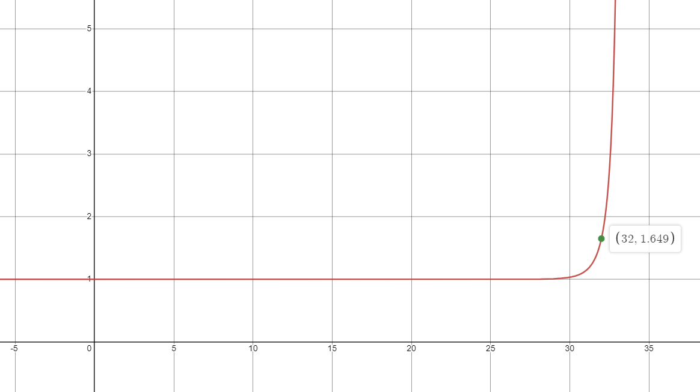
$$f\left(x\right)={\left(1−\frac{2^{x}−1}{2^{64}}\right)}^{−\frac{2^{x}}{2}}$$
45

Slide 46
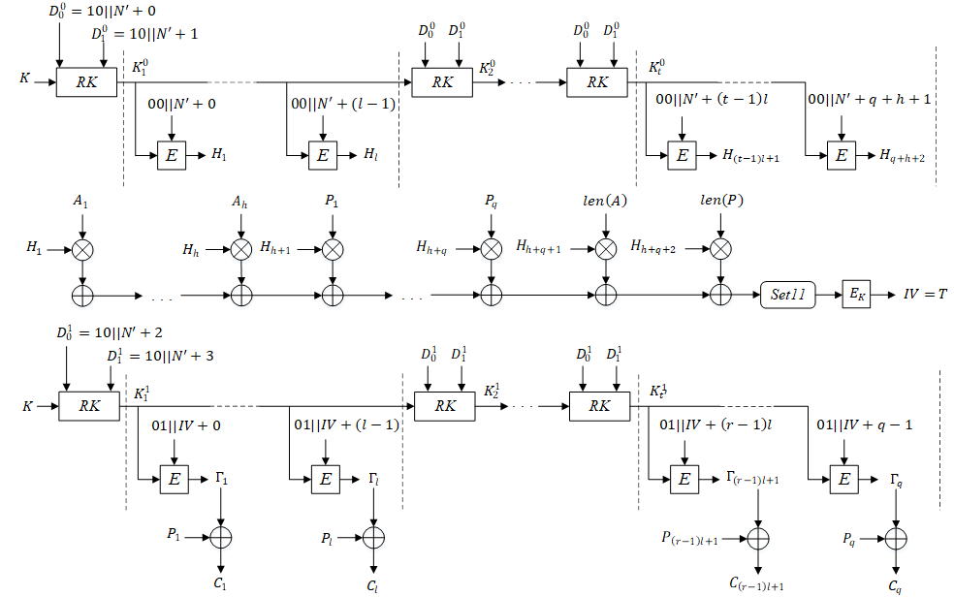
46

